Slide 1
GETTING
STUFF
DONE

Slide 2
EVERYBODY
STAND UP

Slide 3
STRETCH

Slide 4
OK,
SIT DOWN

Slide 5
STEVE

Slide 6
All knowing Wikipedia says:
"An engineer is a professional practitioner of engineering, concerned with applying scientific knowledge, mathematics and ingenuity to develop solutions for technical problems"

Slide 7


Slide 8
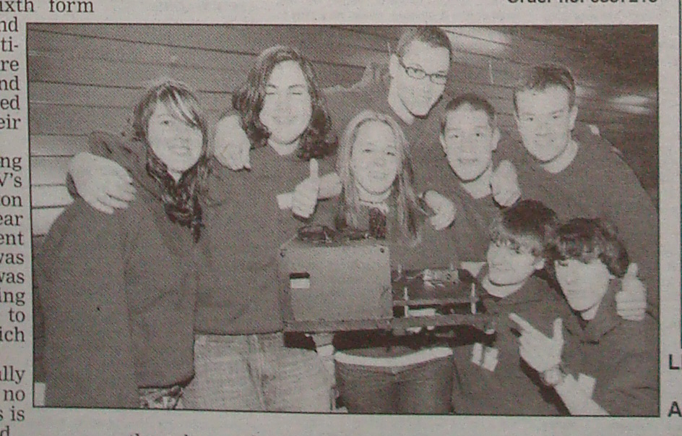

Slide 9
Competition
You
Are
Here
Tech Days
Kickstart
Christmas
Exams
Easter
Sep Oct Nov Dec Jan Feb Mar Apr

Slide 10


Slide 11


Slide 12


Slide 13
GOOD
LUCK

